Slide 1
Audio Forensics Analysis
National Forensic Sciences University, Dharwad Campus
Training on Audio Forensics
Date: 8th November 2025

Slide 2
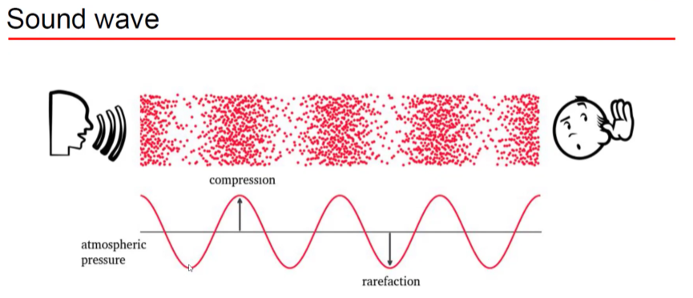
Sound Production and Wave representation

Slide 3
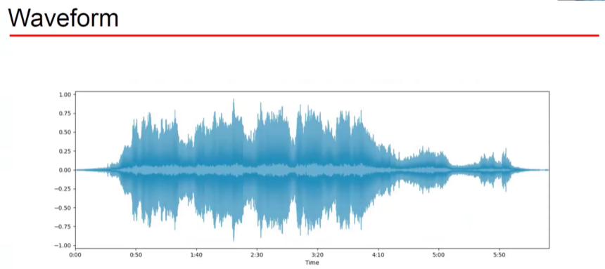
Visualizing Sound: Waveforms can be seen with tools like Audacity, showing amplitude/pressure (y-axis) versus time (x-axis).
Multifactorial information of waveform: Frequency, Intensity, pitch, etc

Slide 4
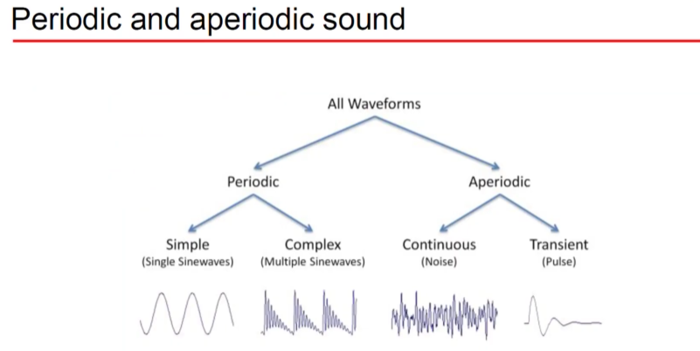

Slide 5
Key Parameters of Audio Signals
Frequency (Hz): Number of oscillations per second (cycle/sec). Inverse of the time period. Defines pitch—higher frequencies = higher pitches.
  Human hearing: 20 Hz to 20,000 Hz (20 kHz).
  Male speech: ~60–5,500 Hz. Female speech: ~150–10,000 Hz.
  Animals: Cats up to 75,000 Hz, dogs up to 45,000 Hz, bats up to 200,000 Hz.
Amplitude: The maximum displacement of the wave from reference. Higher amplitude = louder sound. Amplitude measured from the middle (zero pressure) to peak pressure.

Slide 6
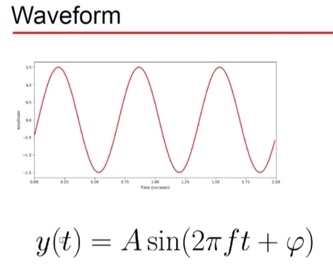
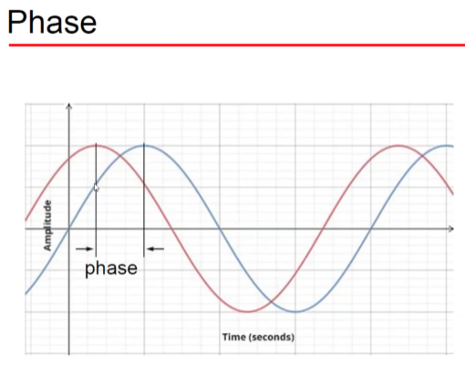
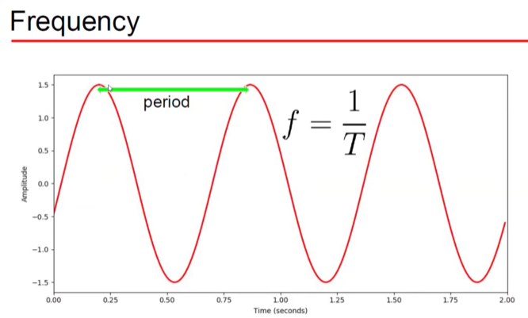
Key Parameters of Audio Signals

Slide 7
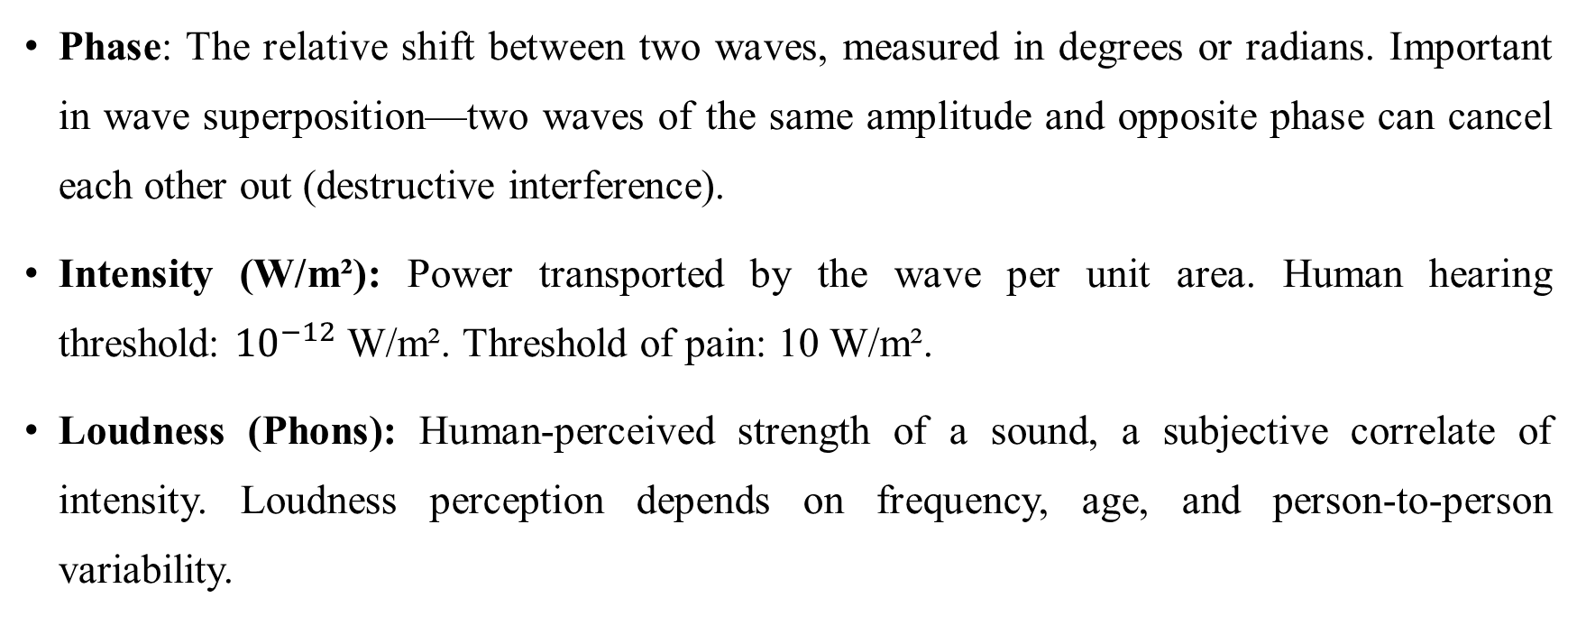
Key Parameters of Audio Signals
Phase: The relative shift between two waves, measured in degrees or radians. Important in wave superposition—two waves of the same amplitude and opposite phase can cancel each other out (destructive interference).
Intensity (W/m²): Power transported by the wave per unit area. Human hearing threshold: ${10}^{−12}$ W/m². Threshold of pain: 10 W/m².
Loudness (Phons): Human-perceived strength of a sound, a subjective correlate of intensity. Loudness perception depends on frequency, age, and person-to-person variability.

Slide 8
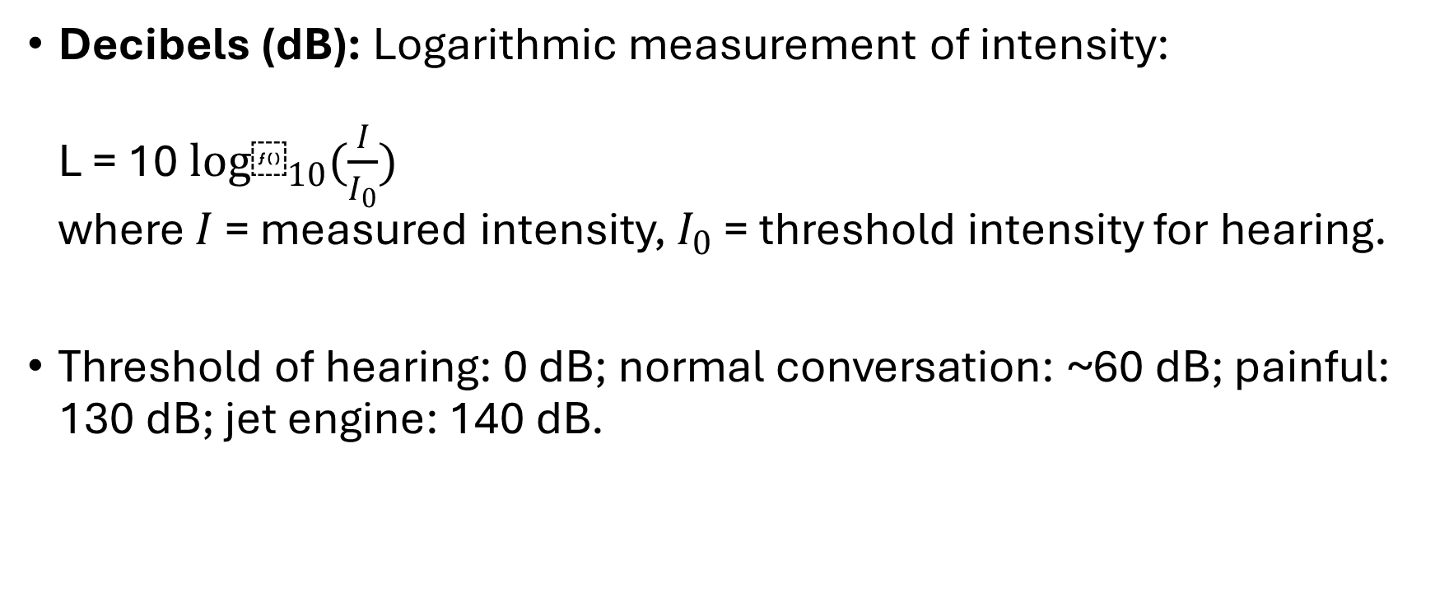
Decibels (dB): Logarithmic measurement of intensity:
L = 10 ${log⁡}_{10}(\frac{I}{I_{0}})$
where $I$ = measured intensity, $I_{0}$ = threshold intensity for hearing.
Threshold of hearing: 0 dB; normal conversation: ~60 dB; painful: 130 dB; jet engine: 140 dB.

Slide 9
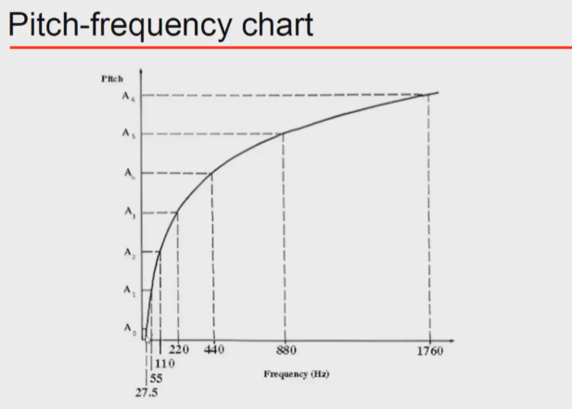
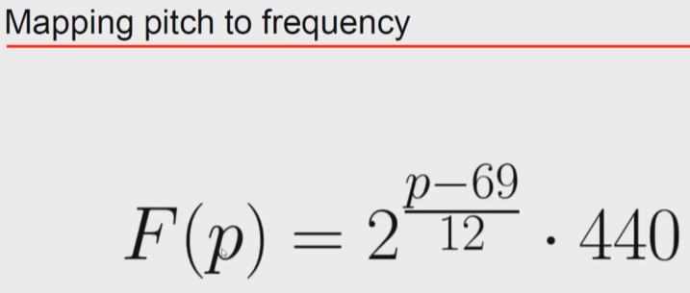
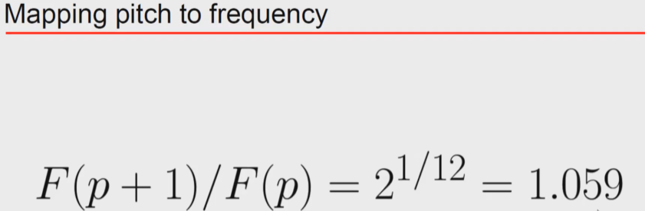
Frequency vs pitch:
Pitch: Psychological perception of frequency, varies logarithmically rather than linearly.
Pitch refers to the perception of the sound. Pitch is how we perceive with our ear.
Frequency refers to the production of the sound.
At pitch=69, F=440Hz
At pitch = 60, F= 261.6Hz

Slide 10
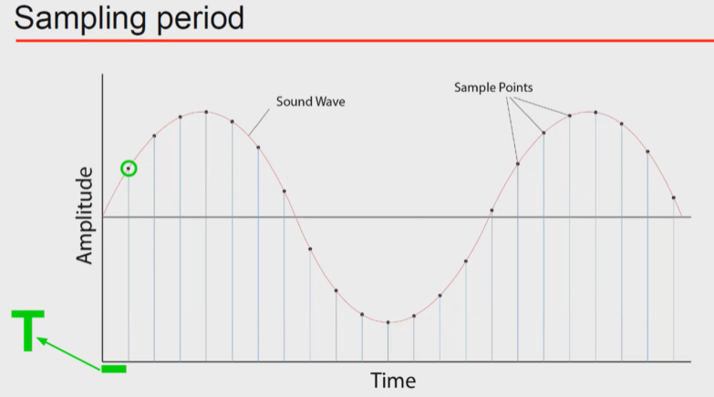
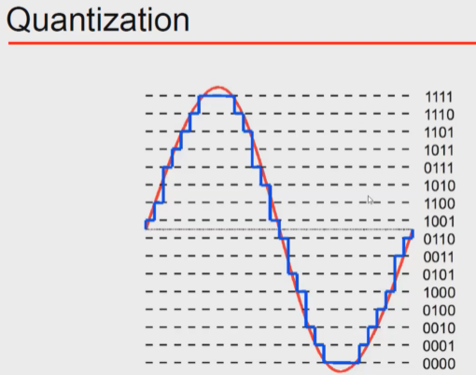
Analog and Digital Signals; Sampling and Quantization
Sampling Frequency based on Nyquist Criteria
Aliasing is Under sampling
CDs use 44.1 kHz to cover human hearing. Max human range frequency is 20kHz. Sampling theorem: Fs= 2*Max frequency.
Resolution = number of bits or bit depth
CD resolution = 16 bits = 65536

Slide 11
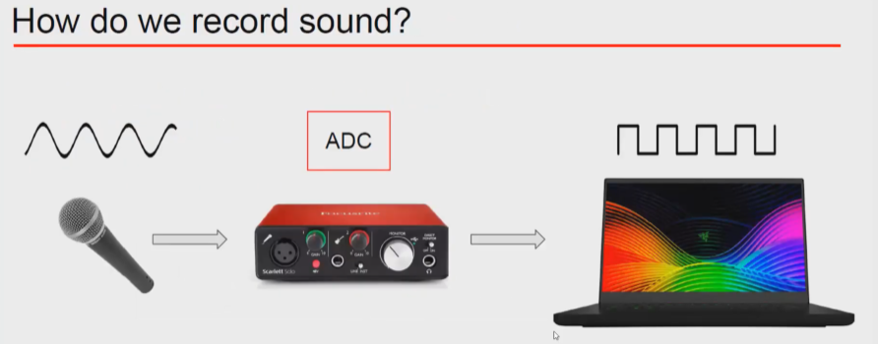
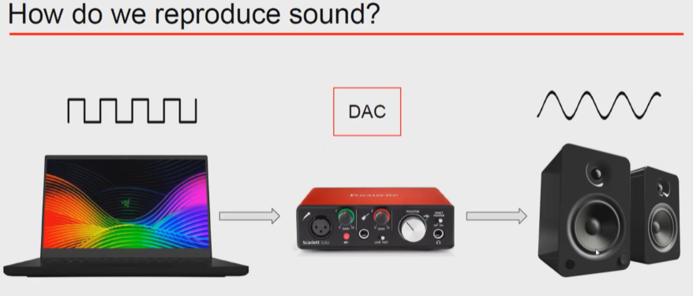
Data Converters-ADC and DAC

Slide 12
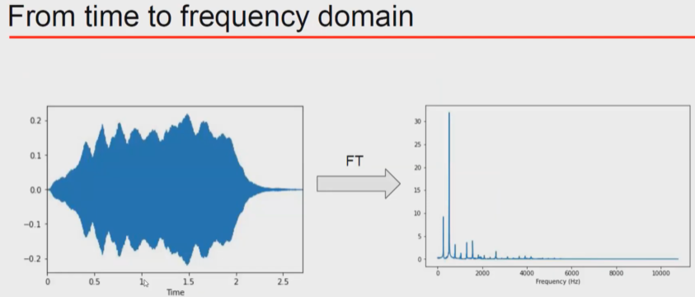
Time and Frequency Domain: Fourier

Slide 13
Challenges in Audio Processing and need for enhancement
Noise: Unwanted sound makes extraction and analysis harder.
Aliasing & Quantization Errors: Bad sampling/poor bit depth reduces fidelity.
Loss of Information: Compression and downsampling can discard important details.
Subjectivity in Loudness/Pitch Perception: Variability in human listeners means technical measurements don't always match perception.

Slide 14
Audio Authentication
Electronic evidence: According to IT Act Chapter 1, sound files are included as electronic records.
Authentication Process Overview
Lab examination
Original/Copied
Social Media Processed?
Critical (Auditory) Listening

Slide 15
Audio Authentication
Pre-Examination Assessment
Always request the original recording or original device.
If unavailable, request details of recording device: make, model, serial number; date, time of copying; details of copying process.
For telephone recordings, request Call Detail Records (CDR) for data verification like length of the recording, time, date and etc.
Maintain and check Chain Of Custody Documents (COD).

Slide 16
Audio authentication-Laboratory Examination
Direct or Telephonic Recording
Using the following features, the direct and telephonic recordings can be identified easily:
  i. The sampling rate: 8000 Hz for Tele
  23000 Hz or more for Direct
  ii. Background Noise:
  Low Tele
  High Direct
  iii. Metadata/HEX data properties to be verified

Slide 17
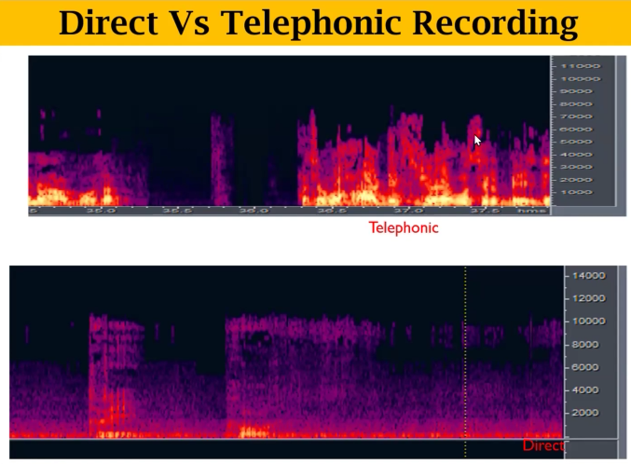

Slide 18
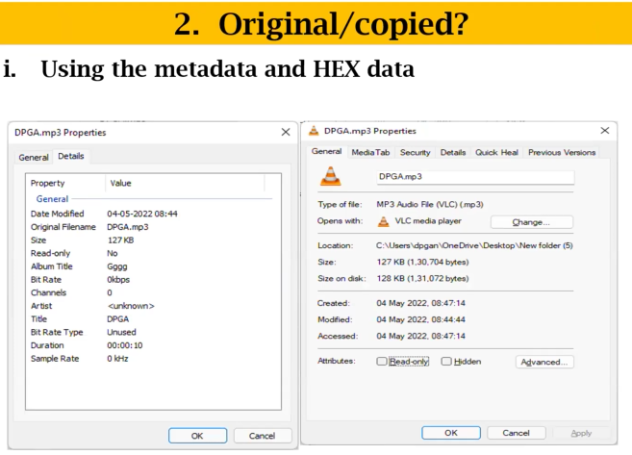
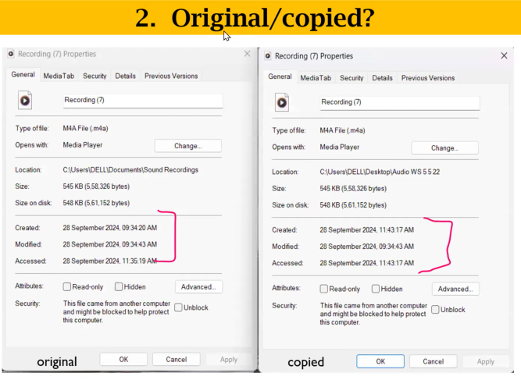
Metadata Analysis
Extracts technical info from the audio file (e.g., filename, format, duration, bitrate, encoder, hash values).
Confirm file properties match stated characteristics
Check hash values for integrity
Look for signs of re-encoding or editing

Slide 19
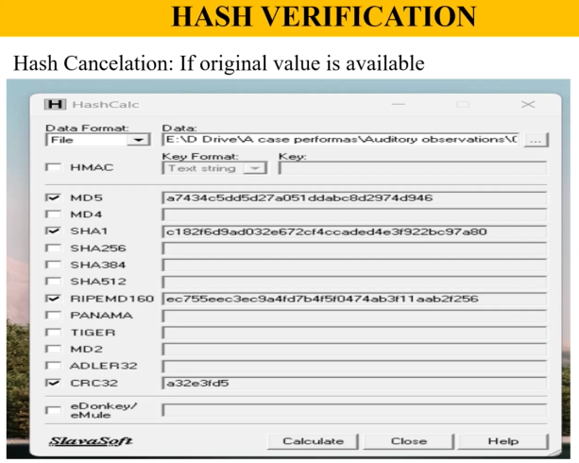
Hash Values
Online Hash calculator: https://md5file.com/calculator
Inference for Audio Forensics:
If these hash values match the hashes taken from an original device, the audio file is considered authentic, untampered, and reliable as evidence.
If hashes differ, it indicates modifications, edits, or possible tampering, which must be flagged in forensic analysis and reporting.
Analyze with OSI tools, MediaInfo, Mediatape, Hex editors, or scripts (e.g., Python).
Check parameters: sampling rate, codec, bit rate, device name, and editing history.

Slide 20
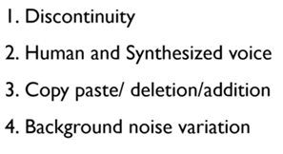
Waveform Analysis:
  Visual comparison to spot discontinuities, sharp cuts, or faces that don’t match up.
  Difficult to detect if edits are made with technical precision (phase-aligned cutting).
  Human vs. synthesized/AI voice detection:
    Human speech naturally exhibits variation; synthesized or programmatic voice segments show near-identical waveforms repeatedly.

Slide 21
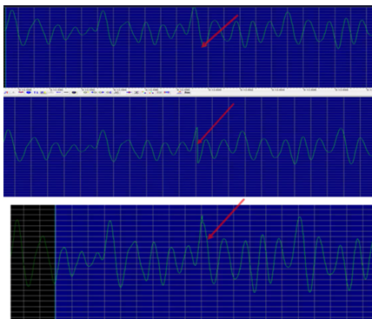
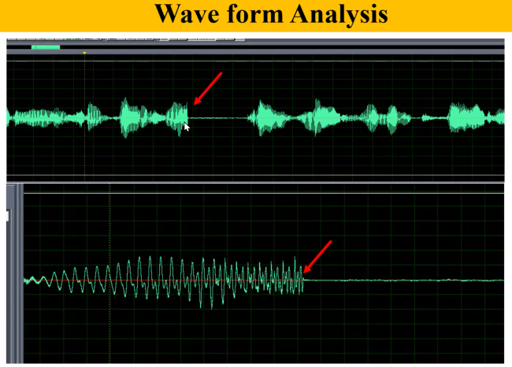
Waveform Analysis:

Slide 22
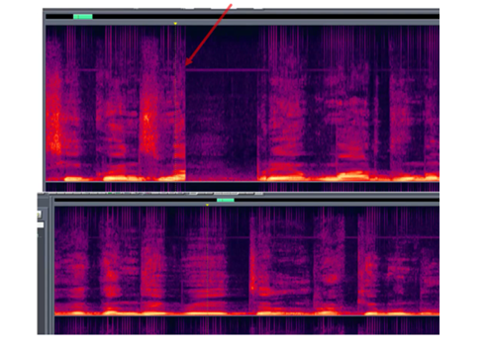
Spectro graphical analysis
Visualizes frequency content over time.
Look for abrupt frequency changes or repeated patterns
Sudden start/stop bands suggest edits or synthetic content

Slide 23
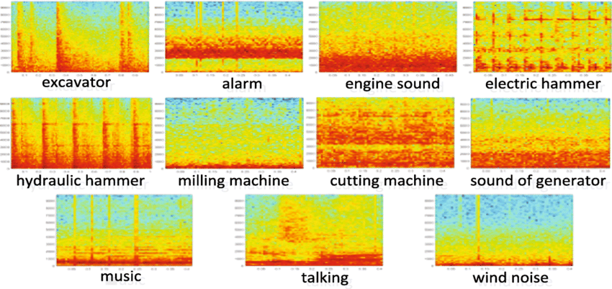
Spectrogram Analysis

Slide 24
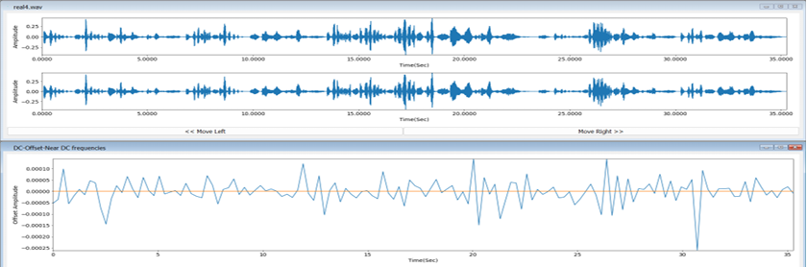
DC Shift Analysis
Measures whether the center line of the waveform is offset from zero.
Large DC offset = improper recording or editing

Slide 25
Statistical Parameters
Skewness, Kurtosis: indicate amplitude distribution shape
SNR (Signal-to-Noise Ratio): higher = clearer audio
Silence/Zero Discontinuity Detection
Checks for unnatural silences or zero blocks.
Natural speech pauses differ from hard cuts or inserted silences

Slide 26
LPC (Linear Predictive Coding) Discontinuity
Analyzes prediction changes over time.
Discontinuities = possible splicing
'No discontinuity found' = likely original audio
ENF (Electric Network Frequency) Variation
Checks continuity of 50Hz power line hum.
Absence or sudden change may suggest manipulation

Slide 27
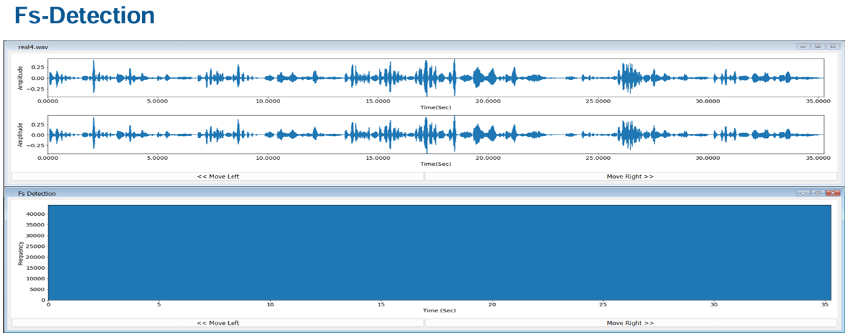
Sampling Frequency Detection
Confirms audio sampling rate (e.g., 44.1kHz).
Mismatch may indicate resampling or re-encoding

Slide 28
Specific Scenarios for Authentication & Appropriate Techniques
Audio File Scenario | Techniques | Outcome/Opinion
Original file on original device like mobile phone | Metadata, Hash | Conclusive authentication possible
File copied to another device, but original available like cd or pendrive with souce | Metadata, Hash, Auditory, waveform form, Spectrograph | Strong opinion possible
File only on CD/drive, not social media processed | Metadata, Auditory, waveform-form, Spectrograph | Concrete or continuity-only
File from social media but present in device | Mostly Auditory, waveform form, Spectrograph | Only continuity possible

Slide 29
Some OSI tools for Audio Signal Analysis
Audacity
Praat
Hash Calc
Sonic Visualizer

Slide 30
Thank you

